Slide 1

JavaScript
01-06-2024

Slide 2
Prerequisites
Basic JavaScript Syntax:
Variables
Data types
Operators
Functions
Basic syntax

Slide 3
Learning objectives
Operators
Comparison Operators
Logical Operators
Control flows
Conditional statements
Loops

Slide 4
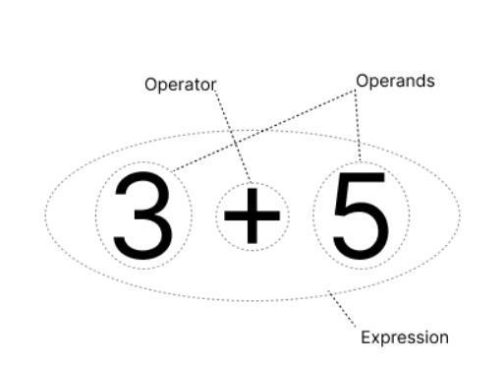
Operator, Operand & Operation
Operator
Operand
Expression/Operation

Slide 5
Operators
Operators are used to perform different types of mathematical and logical computations.
Operator types
Arithmetic
Assignment
Comparison
Logical
Unary
Ternary
Etc.

Slide 6
Comparison Operators
Comparison operators are used in logical statements to determine equality or difference between variables or values.
Equal to: == or ===
Not equal to: != or !==
Greater than: >
Less than: <
Greater than or equal to: >=
Less than or equal to: <=

Slide 7
Logical Operators
Used to combine conditional statements.
Logical AND: &&
Logical OR: ||
Logical NOT: !

Slide 8
Unary, Binary, and Ternary
Unary operators: which require one operand (Un)
Binary operators: which require two operands (Bi)
Ternary operators: which require three operands (Ter)

Slide 9
Unary Operator
typeof "hello" // string
+"200" // 20 - number
+false // 0 - number
+"hello" // NaN
const array = [2,3,4]
delete array[2]
console.log(array) // [ 2, 3, <empty> ]
increment ++, decrement ++, and Logical NOT !

Slide 10
Binary Operator
Arithmetic Operators
10 + 20 // 30
20 - 5 // 15
30 / 6 // 5

Slide 11
Conditional (Ternary) Operator
The conditional (ternary) operator in JavaScript is a concise shorthand for an if-else statement.
It assigns values to variables based on a condition, returning one of two expressions depending on whether the condition evaluates to true or false.

Slide 12
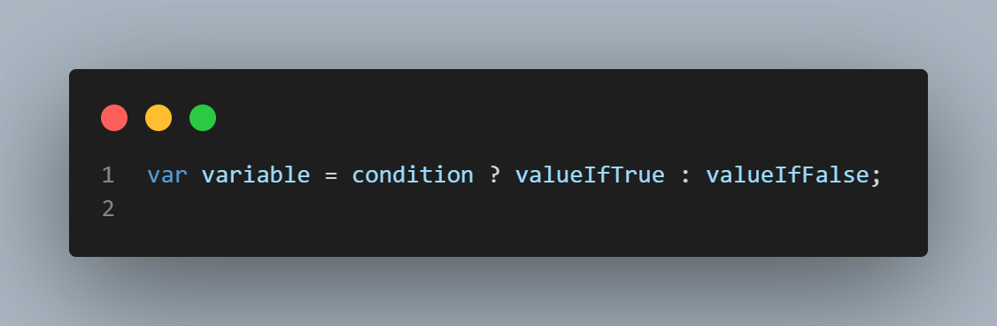
Conditional (Ternary) Operator
Syntax

Slide 13
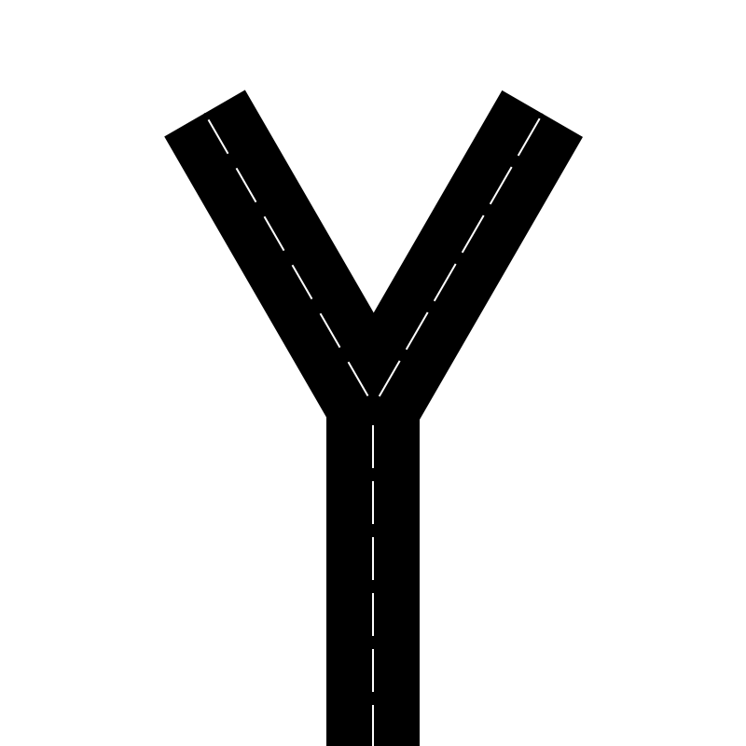


Control flows
Veerasinkam hall
Pannai Beach
(Condition 1)
(Condition 2)
Unicom TIC
Conditional
Loops

Slide 14
Control flows
Control flow refers to the order in which statements in a program are executed.
It determines the path a program takes based on different conditions and decisions made during runtime.
In simpler terms, control flow directs the flow of execution within a program, allowing it to respond dynamically to various situations.

Slide 15
Types of Control Flows
Control flows primarily consist of conditional statements and loops, which allow control of the flow of execution in their code based on different conditions and to iterate over data structures.
Conditional statements
Loops
Iterating over Data Structures

Slide 16
Conditional Statements
Conditional statements are used to execute different blocks of code based on specified conditions.
Types of Conditional Statements:
if statement
if...else statement
nested if...else statement
switch statement

Slide 17
if statement
Executes a block of code if a specified condition is true. If the condition evaluates to false, the code block is skipped.

Slide 18
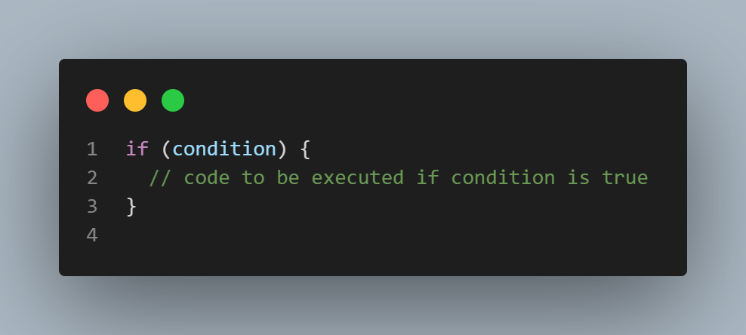
if statement
Syntax

Slide 19
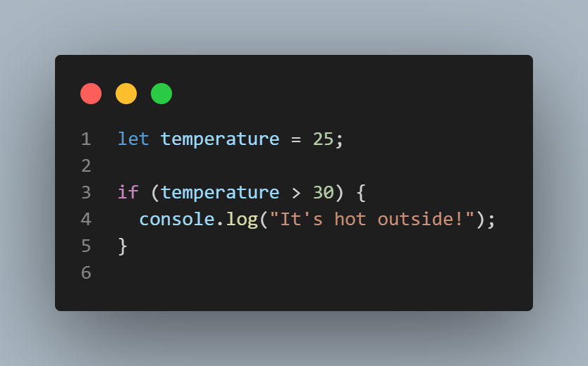
if statement

Slide 20
if...else statement
Executes one block of code if a specified condition is true and another block of code if the condition is false.

Slide 21
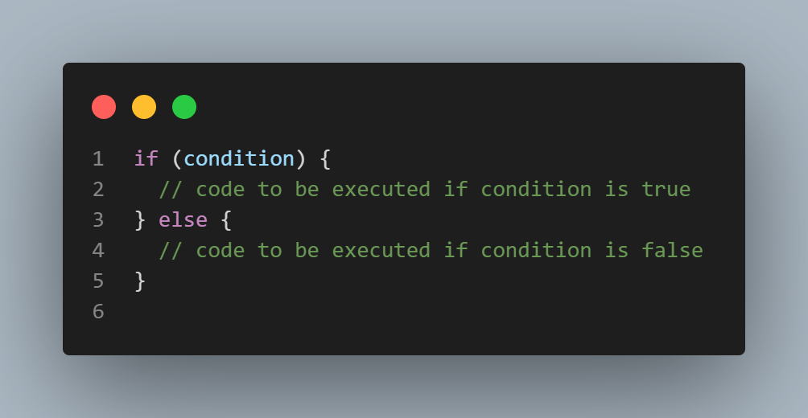
if...else statement
Syntax

Slide 22
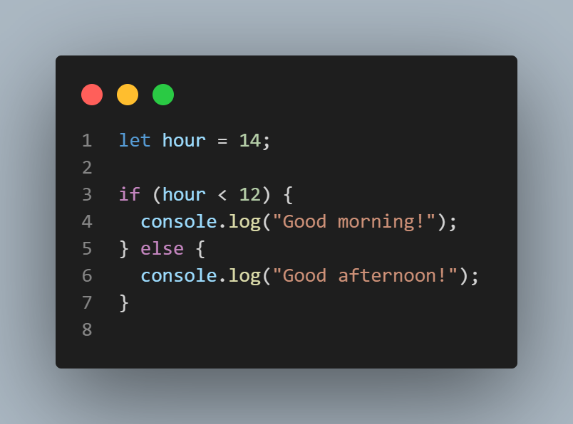
if...else statement

Slide 23
nested if...else statement
Allows for multiple conditions to be evaluated hierarchically, enabling more complex decision-making scenarios.

Slide 24
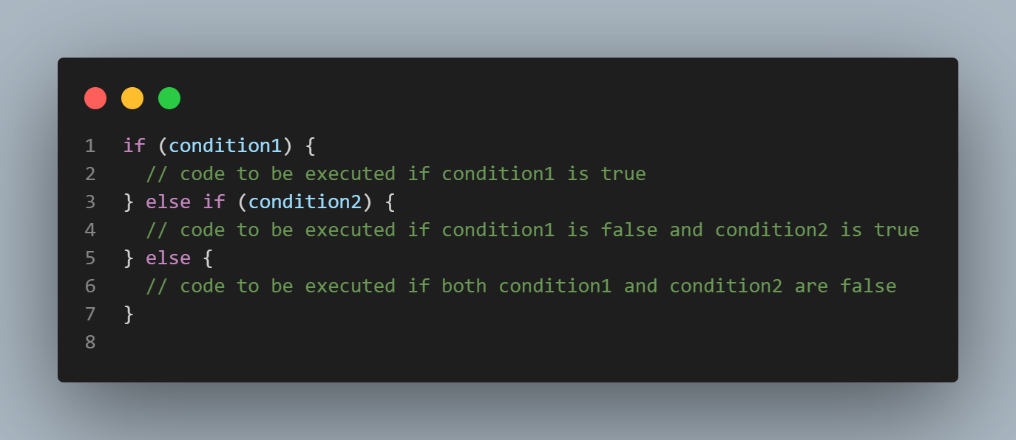
nested if...else statement
Syntax

Slide 25
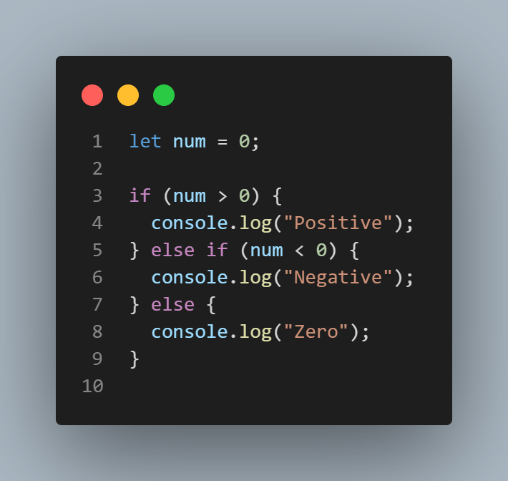
nested if...else statement

Slide 26
switch statement
Use the switch statement to select one of many code blocks to be executed.

Slide 27
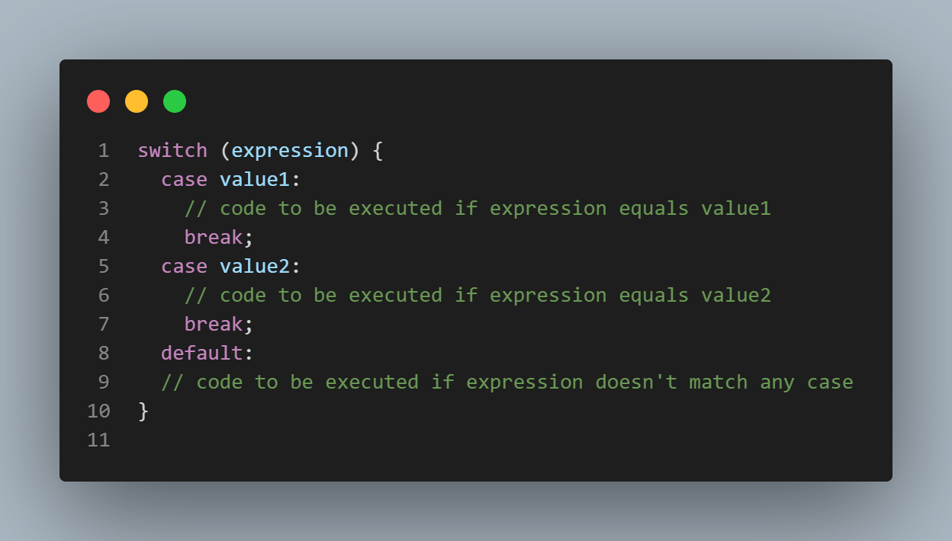
switch statement
Syntax

Slide 28
switch statement
This is how it works:
The switch expression is evaluated once.
The value of the expression is compared with the values of each case.
If there is a match, the associated block of code is executed.
If there is no match, the default code block is executed.

Slide 29
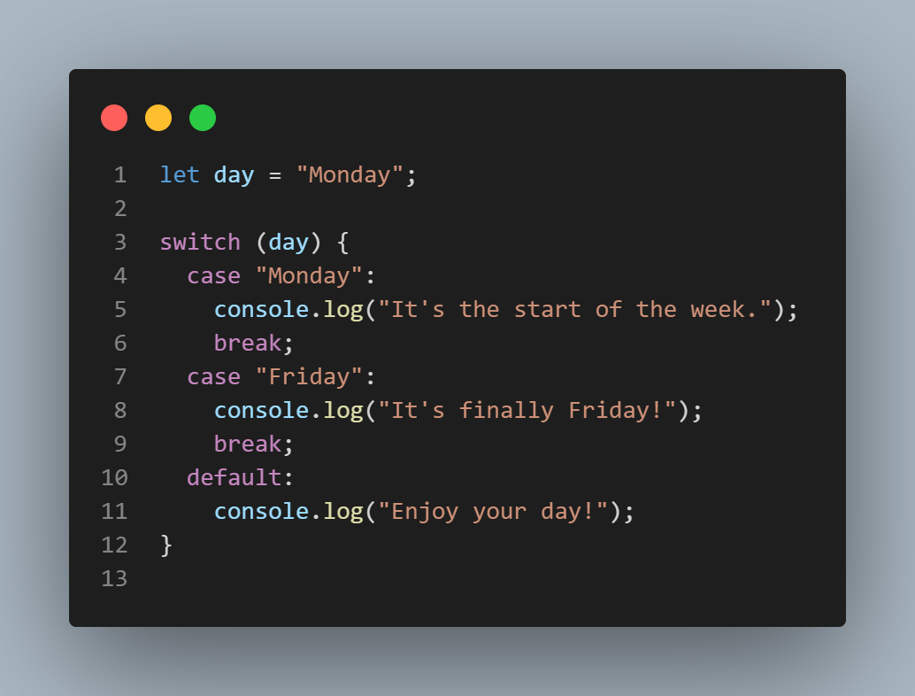
switch statement

Slide 30
Loops
Loops are used to execute a block of code repeatedly.
Loops execute a block of code repeatedly until a specified condition is met.
Types of Loops:
for loop
while loop
do...while loop

Slide 31
for loop
The for loop is used to iterate over a block of code a specified number of times.
It consists of an initialization, a condition, and an iteration expression.

Slide 32
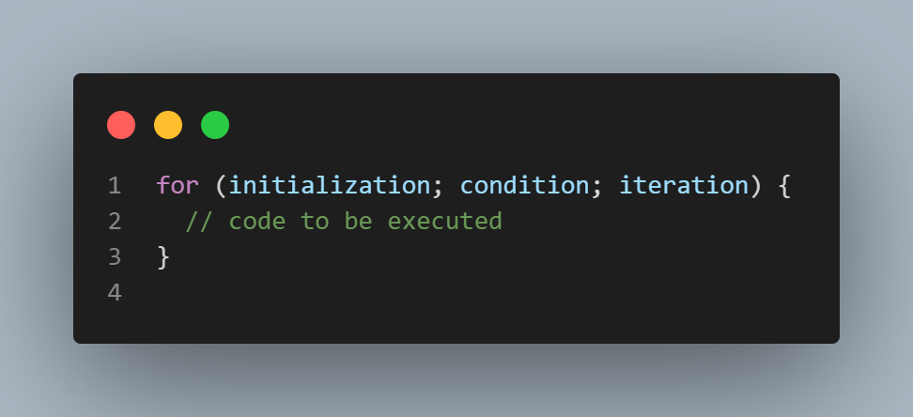
for loop
Syntax

Slide 33
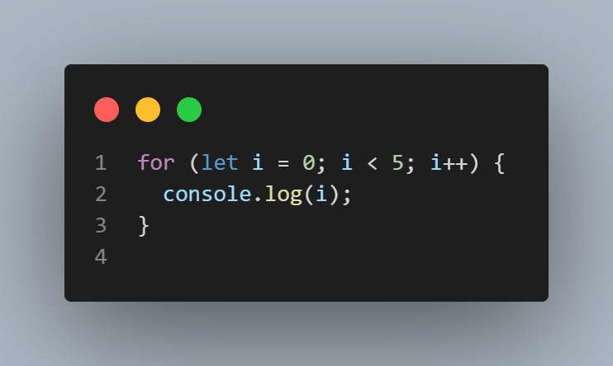
for loop

Slide 34
while loop
The while loop executes a block of code as long as a specified condition is true.
It only has a condition expression.

Slide 35
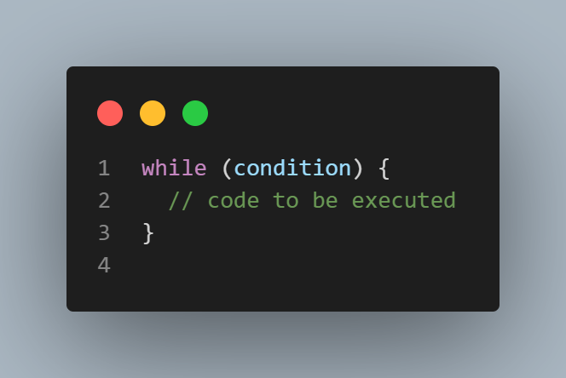
while loop
Syntax

Slide 36
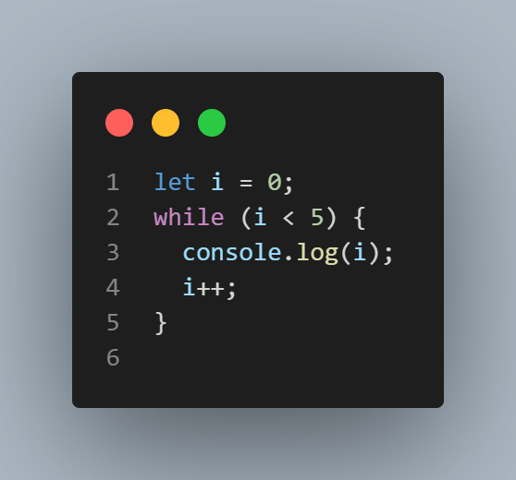
while loop

Slide 37
do...while loop
The do...while loop is similar to the while loop but ensures that the block of code is executed at least once before the condition is checked.

Slide 38
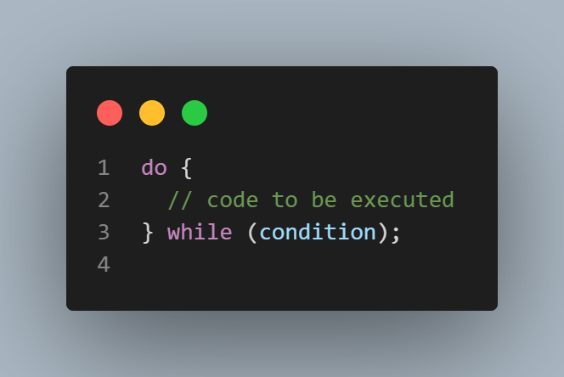
do...while loop
Syntax

Slide 39
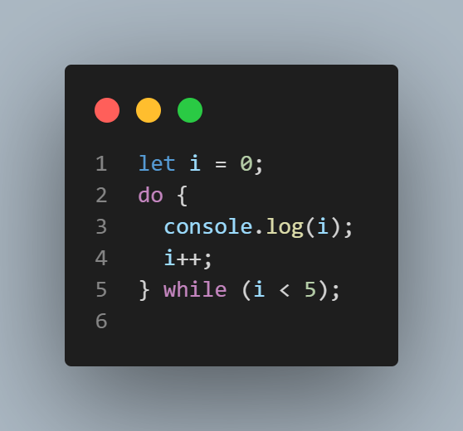
do...while loop

Slide 40
break
The break statement is used to exit the current loop prematurely, regardless of whether the loop's condition has been fulfilled.

Slide 41
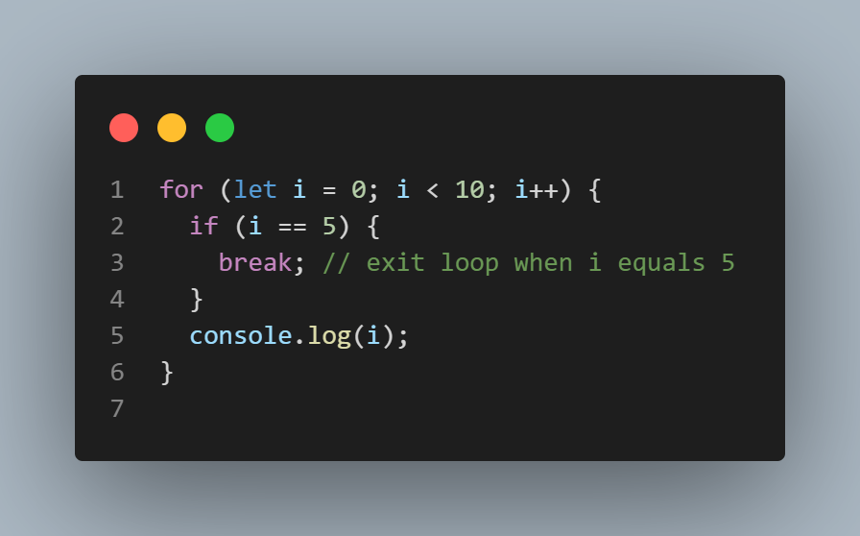
break

Slide 42
continue
The continue statement is used to skip the current iteration of the loop and proceed to the next iteration.

Slide 43
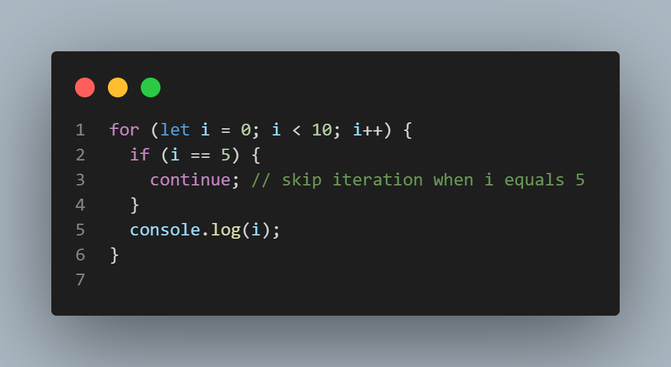
continue

Slide 44
Takeaway
Understanding Boolean data types and logical operations is crucial for making decisions and controlling program flow.
Control flows are fundamental for directing program execution and managing data effectively.
Conditional statements like if, if...else, nested if...else, and switch allow developers to execute specific code blocks based on varying conditions.
Loops like for, while, and do...while help developers automate repetitive tasks and navigate through data structures with ease.
Keywords like 'break' and 'continue' facilitate the interruption of loops or skipping of specific iterations as needed.

Slide 45
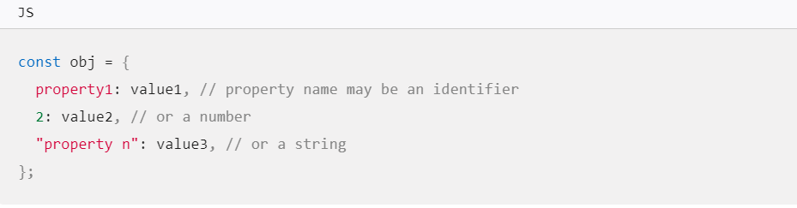
Working with objects
An object is a collection of properties, and a property is an association between a name (or key) and a value.
For example. A cup is an object, with properties. A cup has a color, a design, weight, a material it is made of, etc. The same way, JavaScript objects can have properties, which define their characteristics

Slide 46
Creating new objects
Using object initializers

Slide 47
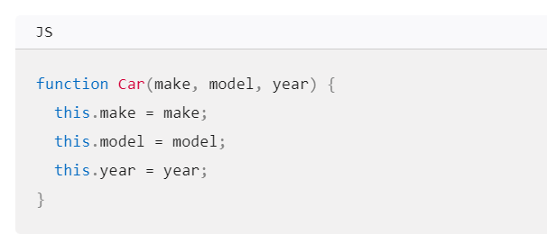
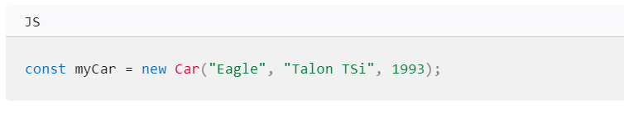
Creating new objects
Using a constructor function

Slide 48
Any Questions?

